Slide 1
GLOWSTONE
Remi Maskulin, Leo Leerilä, Oleg Dukalskiy, Eeli Mäkinen
Ryhmä 1

Slide 2
Use of AI
  This was made fully by humans
GitHub link - https://github.com/LeoLeerila/Glowstone
Trello link - https://trello.com/b/xQvpwM4z/sep1glowstone

Slide 3
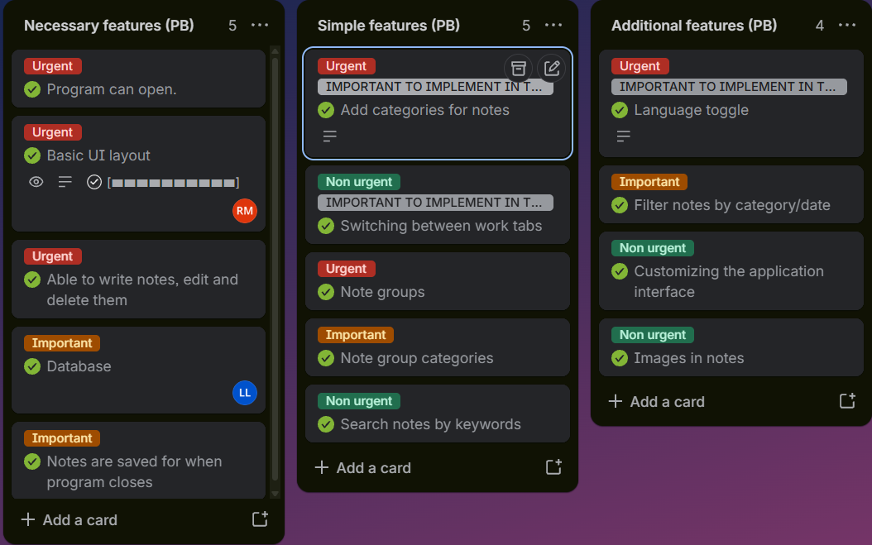
Product Backlog and development process
We implemented the majority of necessary features first, before touching non-essential features.
Group members took tasks under their responsibility
All features got implemented on a timely manner

Slide 4
Sprint 1
Statistics on the sprint implementation:
  Sprint Master: Remi
  Sprint Backlog
    Chose project topic and assigned responsibility roles
    Project Plan & Vision documents
    Product backlog and user stories

Slide 5
Sprint 2
Statistics on the sprint implementation:
  Sprint Master: Oleg
  Sprint Backlog
    Done & Released
      Frontend basic layout and frontend-only methods
      Backend implemented with SCRUM
      JaCoCo implemented
      JUnit starter tests
    Testing
      Basic testing implemented for backend

Slide 6
Sprint 3
Statistics on the sprint implementation:
  Sprint Master: Leo
  Sprint Backlog
    Done & Released
      Frontend communication with Backend
      Database implemented
      Jenkins implemented
      Remaining frontend features implemented
    Testing
      Implemented new tests with Database connection in mind
      Some tests were postponed

Slide 7
Sprint 4
Statistics on the sprint implementation:
  Sprint Master: Eeli
  Sprint Backlog
    Done & Released
      Docker image implemented
      Remaining JUnit tests
    Postpone
      Frontend UI visual enhancements

Slide 8
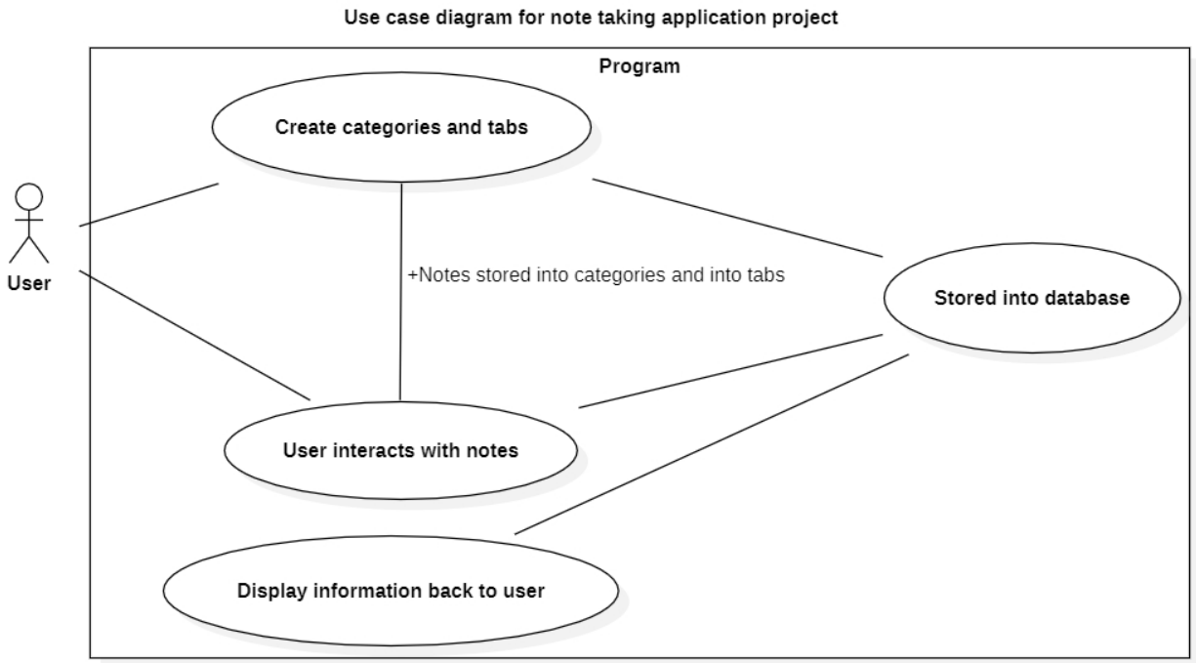
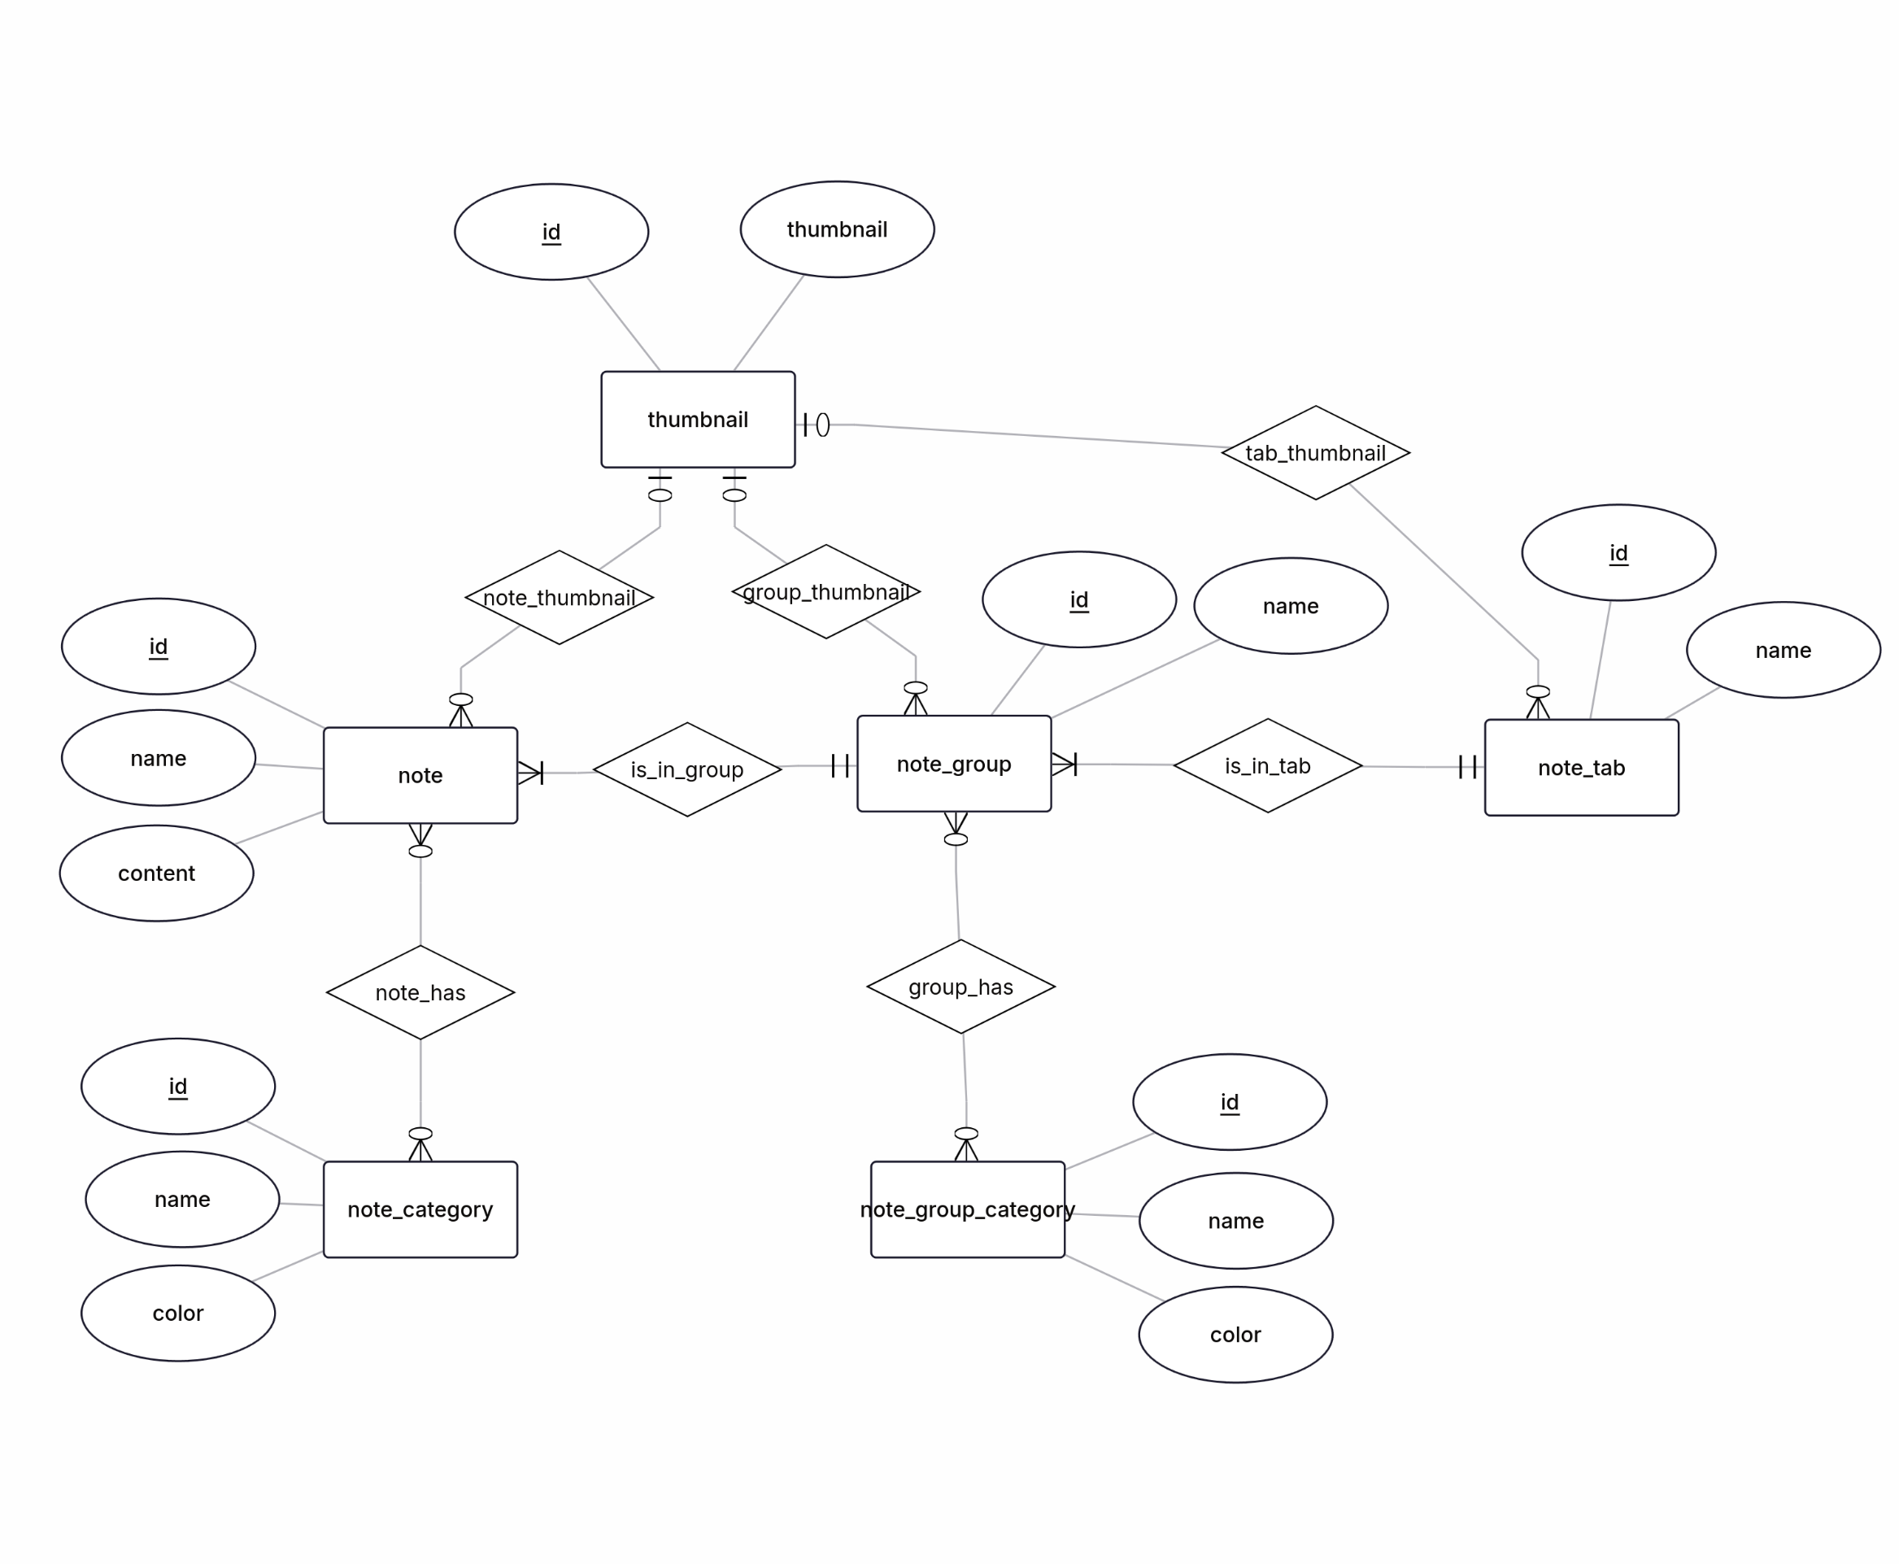
Architectural Design

Slide 9
Applied Technologies
Junit
Jacoco
Jenkins
Docker
JavaFX
MariaDB

Slide 10
Demo
5 minutes maximum
  Prototype demo (Docker image)

Slide 11
Validity and reliability of your Solution
How did you ensure your software is reliable?
We opened the program. It work. 👍 (ad-hoc testing)
Junit tests used to ensure methods work as expected.

Slide 12
Learning achievement of this course
Learned use of Docker and Jenkins.
Learned about CI/CD principles.

Slide 13
Plan for further development
Make improvements to UI
Make improvements to Filtering
Make notes customizable
Make improvements to Tests

Slide 14
Thank you

